Slide 1

Master-Thesis Methodical Approach for Analyzing Process Parameters and Optimizing Boundary Conditions in Multi-Axis Robot Programs
Status Update: Week 12
18.12.2023 – 24.12.2023
Jan Nalivaika

Slide 2
Progress
Exposé Done == DONE ☺
All Comments implemented == DONE ☺
Abbreviations == DONE ☺
Rundung in „Direction Changes“ analysieren == DONE ☺

Slide 3
G - Commands
G60 = the points are reached exactly, but the feedrate is reducing to 0 at every waypoint
G641 = Bahnsteuerbetrieb mit Überschleifen nach Wegkriterium (ADIS=0.5)
GLOBALE BEFEHLE:
G601:
Befehl zum Aktivieren von Genauhalt-Kriterium "Genauhalt fein"
G602:
Befehl zum Aktivieren von Genauhalt-Kriterium "Genauhalt grob"

Slide 4
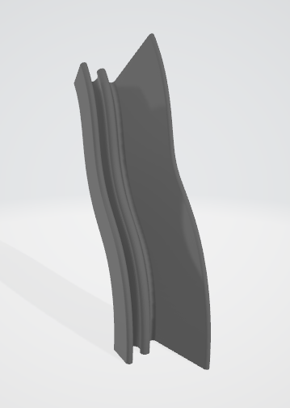
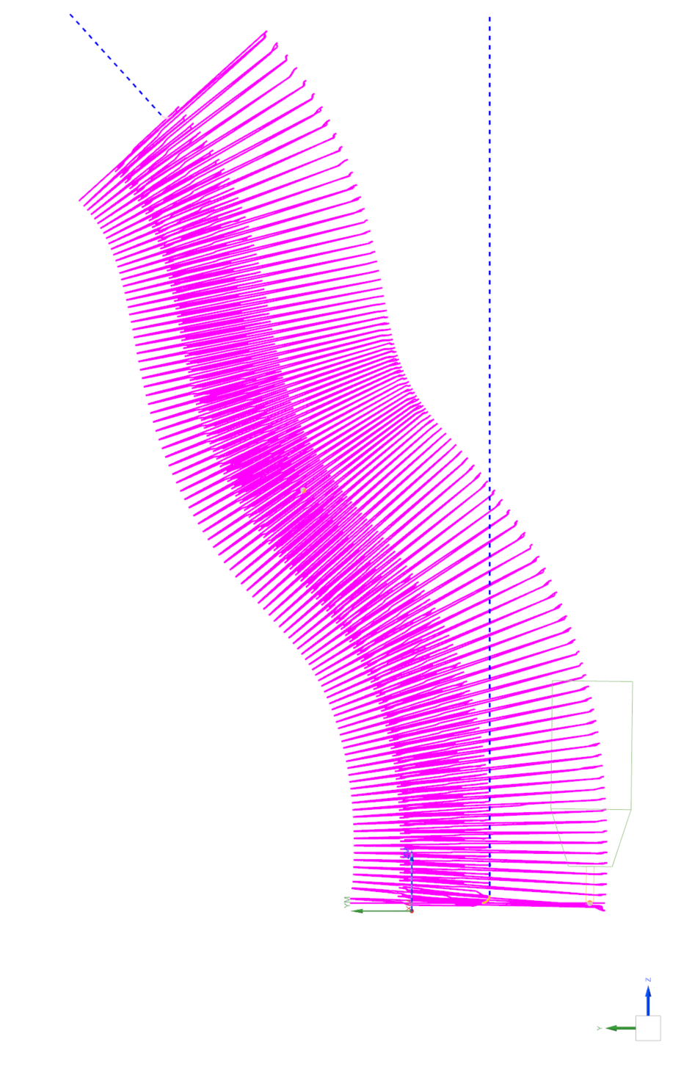
Real Gcode
Show GIF of robot with moving base
Show STL in viewer

Slide 5
Result

Slide 6
Global Score

Slide 7
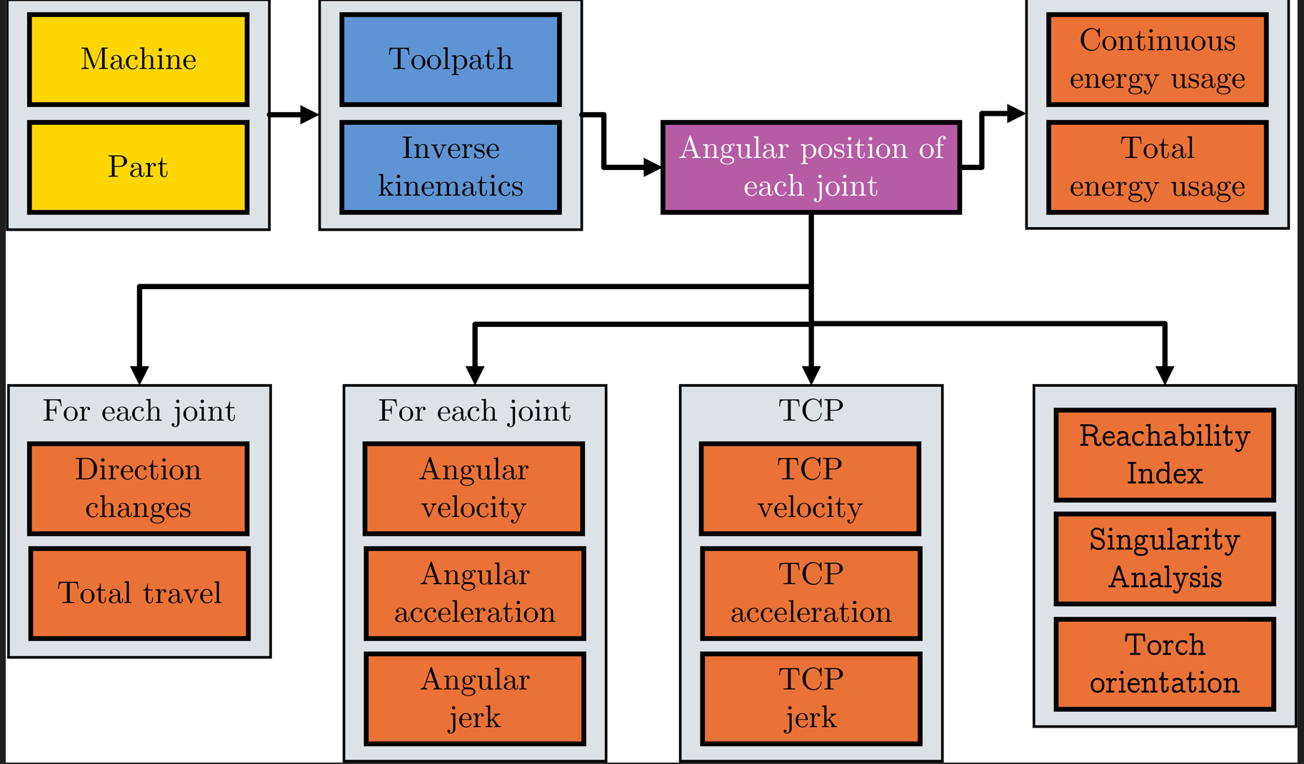
Images

Slide 8
2 Weeks to Finish
Current Status: 1+2+3 = Done
Finalize Chapter 4
Real Gcode – Write Validation
Summery – Write
Finalize Chapter 5
Conclusion – Write
Outlook – Write
Abstract – Write
Formatting
Colors in text (images)
What could be done:
Real DH Parameters
TCP Transformation
Rotary-Tilt table Adaption
Add 3rd DOF (Rotation)
Bigger Gcodes
Quellen ()

Slide 9
Contact
Jan Nalivaika (TUM) Student Otto-Hahn-Ring 6
81739 Munich, Germany
Phone +49 163 7180148
E-mail jan.nalivaika.ext@siemens.com nalivaika@outlook.de
Marius Breuer (Siemens AG)
Supervisor Otto-Hahn-Ring 6
81739 Munich, Germany
Phone +49 (172) 8396287
E-mail marius.breuer@siemens.com
Ludwig Siebert (TUM-IBW)
Supervisor Boltzmannstr. 15
85748 Garching at Munich
Phone +49 (89) 289 – 15578
E-mail ludwig.siebert@iwb.tum.de

Slide 10
Christmas planning
DATE: Ludwig Marius Jan
29.12 X X
05.01 ☺ (PDF update)
12.01 ☺
19.01 X
26.01 X
02.02 ☺
09.02 ☺
16.02 ☺
23.02 ☺
01.03 ☺
08.03 Last possible Changes in PDF
15.03 Defense
22.03
29.03

Slide 11
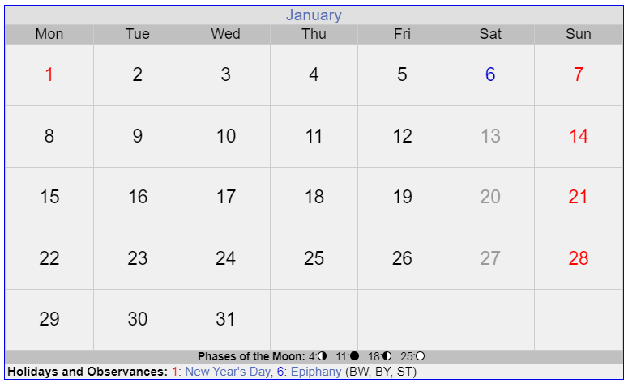
11 Tage
Januar

Slide 12
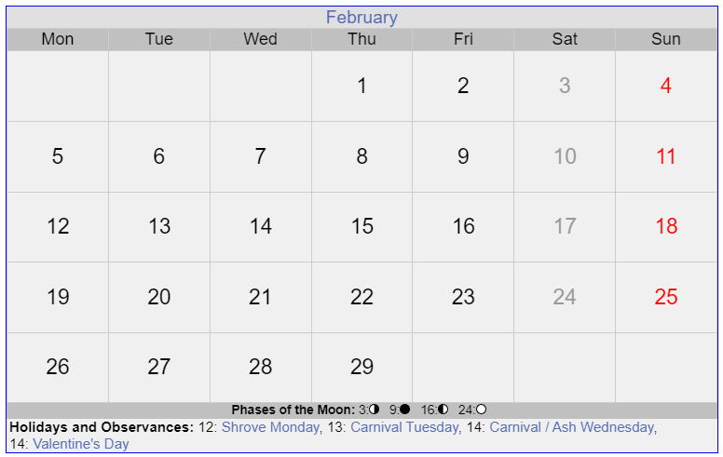
Final PDF
Paper
Paper
12 Tage
Januar

Slide 13
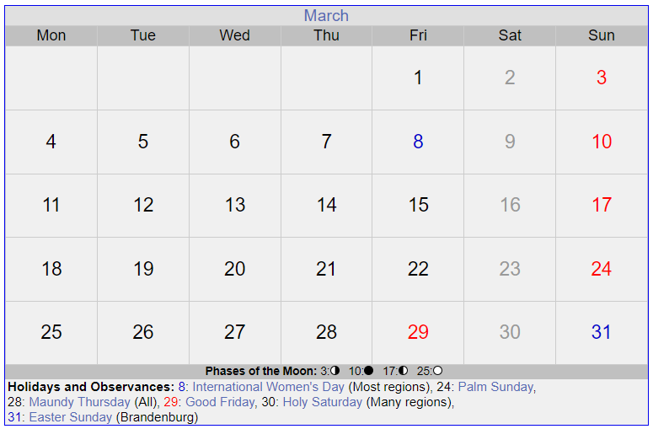
Paper
Paper
Verteidigung
PowerPoint für Verteidigung

